Slide 1
Spooooooky SQL

Slide 2
Spooky SQL Stories
Scary Stories on How to Avoid:
FRIGHTENING nonsequential newsequentialid() GUIDs
SHOCKING foreign key behavior
Duplicate primary key TERROR
Features of night, brought to light!

Slide 4
Fright #1
Behold, the fright of the newsequentialid()!

Slide 5
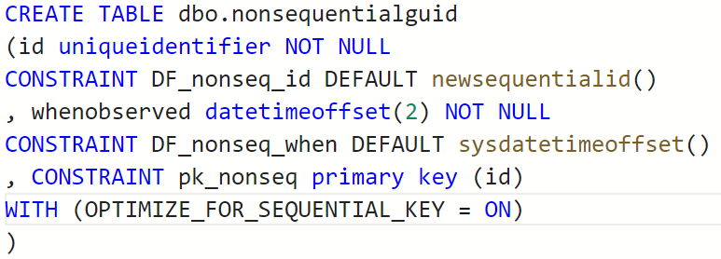
Consequential newsequentialid()
To set the stage …

Slide 6
Consequential newsequentialid()
Ran some inserts,
caused some things to happen,
and then…

Slide 7
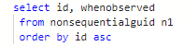
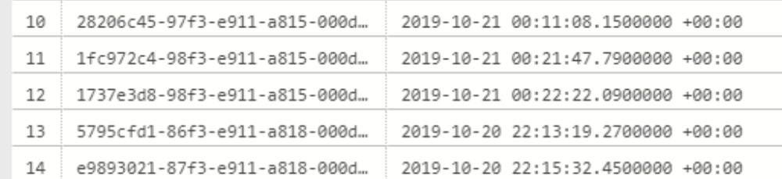
Consequential newsequentialid()

Slide 8
INSERT SORT ORDER
Expected behavior
of newsequentialid()
Actual behavior
when seed changes
Server change!
Server change!
Server change!
Server change!
Server change!
Server change!
Server change!
No Fragmentation
Fragmentation Upon Insertion

Slide 9
Consequential Nonsequential
UuidCreateSequential is based on the MAC address of the NIC.
Newsequentialid() seed can change on any change to the server NIC MAC

Slide 10
Too many ways this could happen!
Any Failover to FCI or AG
Upgrade/Migration to new hardware/platform
Change the tier of Azure SQL DB
Reimage an Azure VM with ephemeral OS
Docker run without explicit MAC
On startup of VM in VMWare or HyperV
Any change to the NIC’s MAC

Slide 11
MAC change could even happen on startup!
VMWare: “The MAC address of a powered-off virtual machine is not remembered. Thus it is possible that when a virtual machine is powered on again it can get a different MAC address.” https://kb.vmware.com/s/article/219
“Hyper-V will generate an initial MAC address for the network adapter, and it will regenerate the MAC address if it believes it is necessary.” https://blogs.msdn.microsoft.com/virtual_pc_guy/2010/05/14/hyper-v-and-dynamic-mac-address-regeneration/

Slide 12
Consequential newsequentialid()
Don’t trust newsequentialid()
Use IDENTITY or SEQUENCE instead
Need to merge data?
Use two ints. Half the size of a GUID, sequential and meaningful.
Re: The Oil Rig Scenario.

Slide 14
Fright #2
Behold, the shocking foreign key behavior!

Slide 15
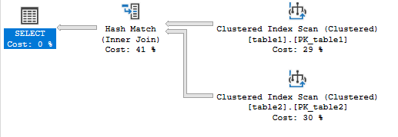
Foreign Keys Magic
SELECT table2.id
FROM table1 inner join table2
ON table1.id = table2.table1id;

Slide 16
Foreign Keys Magic
SELECT table2.id
FROM table1 inner join table2
ON table1.id = table2.table1id;
Add a Foreign Key
on Table2.table1id,
referencing table1.id.

Slide 17
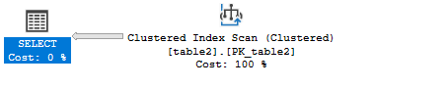
Added a Foreign Key, Same Query
SELECT table2.id
FROM table1 inner join table2
ON table1.id = table2.table1id;
Adding a FK reduced the cost from 1.25 to 0.37 without changing code or indexes!

Slide 18
Spooky Aside… on a Night Like This
Once, this trick demo didn’t work.
Both scans stayed despite my FK. Why?

Slide 19
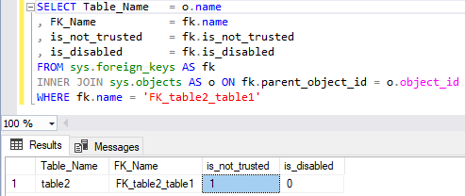
Spooky Aside on a Night Like This
Why might this not work in a demo?

Slide 20
Ever seen SSMS script out a FK like this?
ALTER TABLE dbo.table2 WITH NOCHECK ADD CONSTRAINT FK_table2_table1 FOREIGN KEY(table1id)
REFERENCES dbo.table1 (id);
FK is created, enabled, but not trusted for existing data.

Slide 21
Mic Check Check
Instead of what normally follows:
ALTER TABLE dbo.table2
CHECK CONSTRAINT FK_table2_table1;
What you need is:
ALTER TABLE dbo.table2
WITH CHECK CHECK CONSTRAINT FK_table2_table1;

Slide 22
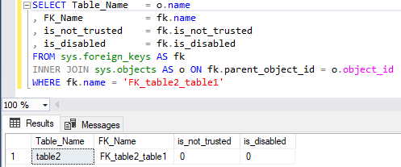
Now NOT not_trusted
After executing WITH CHECK CHECK

Slide 24
Fright #3
Behold, duplicate primary key horror!

Slide 25
Duplicate primary key entries?
Many businesses have an invoice or line item or reference num system like this:
YearInvoice.LineItem
For example:
2019000000100.001
2019000000100.002
2019000000100.003…

Slide 26
Floating Horror
What happens if you use float here, instead of numeric or decimal?
Float/real is a floating point
Approximate numeric data types do not store the exact values.

Slide 27
You Were Warned
Only use float if the max precision of decimal (38 digits!) is insufficient and you’re also ok with rounded results!
Further warnings from Microsoft Docs:
“Avoid using float/real columns in WHERE clause, especially = and <> operators.” https://docs.microsoft.com/en-us/previous-versions/sql/sql-server-2008-r2/ms187912(v=sql.105)?redirectedfrom=MSDN

Slide 28
You Were Warned
In different platforms, floating point data types might be named:
Float
Double
Real
Number (we all hate javascript I know)
Watch out for defaults. Double is often a default.

Slide 29
You Were Warned
For storing numbers to the right of the decimal,
Always,
Always,
Always,
Most of the time,
use [decimal] (precision, scale)
Only use floating points if you know what you’re doing!

Slide 30
Float as PK
Lab - float as pk problems.sql
Spooky factor 5000: ADS vs SSMS

Slide 31
Thanks for your time!
Hopefully you are not too freaked out to enjoy the rest of the October 2020 Baton Rouge User Groups meeting!

Slide 32


William Assaf
Principal Consultant, Microsoft MVP Data Platform
SQLPASS Regional Mentor, SQLSat and UG Co-Organizer in Baton Rouge, La., USA.
Principal Consultant, Sparkhound
SQLTact.com
Co-author, Microsoft Press SQL Server Administration Inside Out 2017 and 2019. MS Cert exam writer since 2012.
linkedin.com/in/williamdassaf
@william_a_dba
Notes:
This presentation is available for download at my blog SQLTact.com.

